Slide 1
7
SERIES OF FUNCTIONS
Copyright © Cengage Learning. All rights reserved.

Slide 2
7.3
Taylor and Maclaurin Series
Copyright © Cengage Learning. All rights reserved.

Slide 3
Taylor and Maclaurin Series
Here we investigate more general problems: Which
functions have power series representations?
How can we find such representations?
We start by supposing that f is any function that can be represented by a power series:
Let’s try to determine what the coefficients c_{n} must be in terms of f.

Slide 4


Taylor and Maclaurin Series
To begin, notice that if we put x = a in Equation 1, then all terms after the first one are 0 and we get
We can differentiate the series in Equation 1 term by term:
and substitution of x = a in Equation 2 gives

Slide 5


Taylor and Maclaurin Series
Now we differentiate both sides of Equation 2 and obtain
Again we put x = a in Equation 3. The result is
Let’s apply the procedure one more time. Differentiation of the series in Equation 3 gives
and substitution of x = a in Equation 4 gives

Slide 6
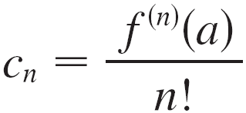
Taylor and Maclaurin Series
By now you can see the pattern. If we continue to differentiate and substitute x = a, we obtain
Solving this equation for the nth coefficient c_{n}, we get
This formula remains valid even for n = 0 if we adopt the conventions that 0! = 1 and f ⁽⁰⁾ = f.

Slide 7
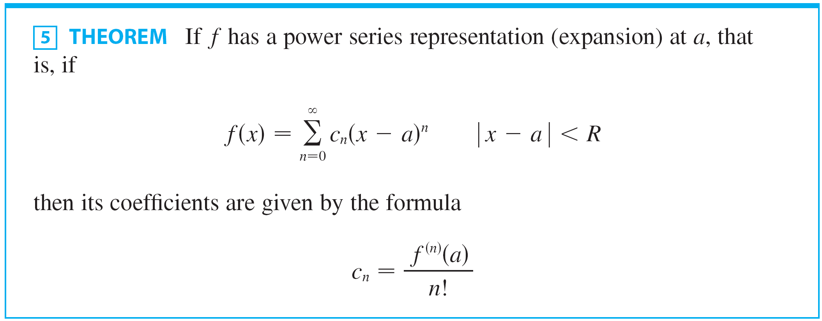
Taylor and Maclaurin Series
Thus we have proved the following theorem.

Slide 8
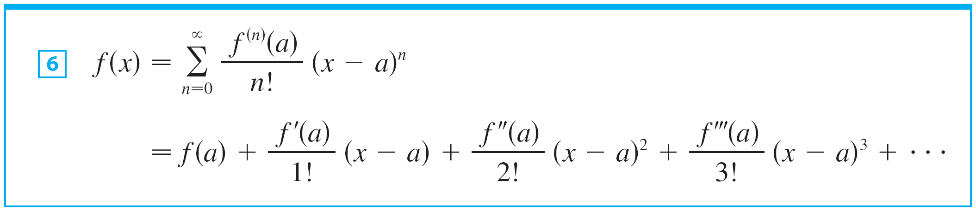
Taylor and Maclaurin Series
Substituting this formula for c_{n} back into the series, we see that if f has a power series expansion at a, then it must be of the following form.
The series in Equation 6 is called the Taylor series of the function f at a (or about a or centered at a).

Slide 9

Taylor and Maclaurin Series
For the special case a = 0 the Taylor series becomes
This case arises frequently enough that it is given the special name Maclaurin series.

Slide 10



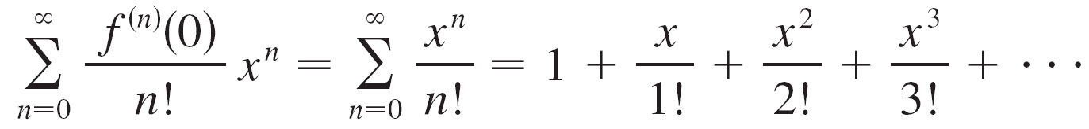
Example 1
Find the Maclaurin series of the function and its radius of convergence.
Solution:
If , then , so for all n.
Therefore the Taylor series for f at 0 (that is, the Maclaurin series) is

Slide 11

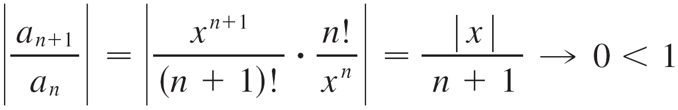

Example 1 – Solution
cont’d
To find the radius of convergence we let
Then
so, by the Ratio Test, the series converges for all x and the radius of convergence is

Slide 12
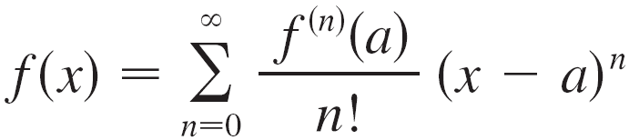
Taylor and Maclaurin Series
Let’s investigate the more general question: Under what circumstances is a function equal to the sum of its Taylor series?
In other words, if f has derivatives of all orders, when is it true that
As with any convergent series, this means that f (x) is the limit of the sequence of partial sums.

Slide 13
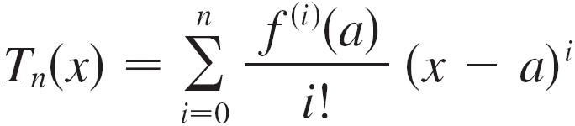
Taylor and Maclaurin Series
In the case of the Taylor series, the partial sums are
Notice that T_{n} is a polynomial of degree n called the nth-degree Taylor polynomial of f at a.

Slide 14

Taylor and Maclaurin Series
For instance, for the exponential function the result of Example 1 shows that the Taylor polynomials at 0 (or Maclaurin polynomials) with n = 1, 2, and 3 are

Slide 15
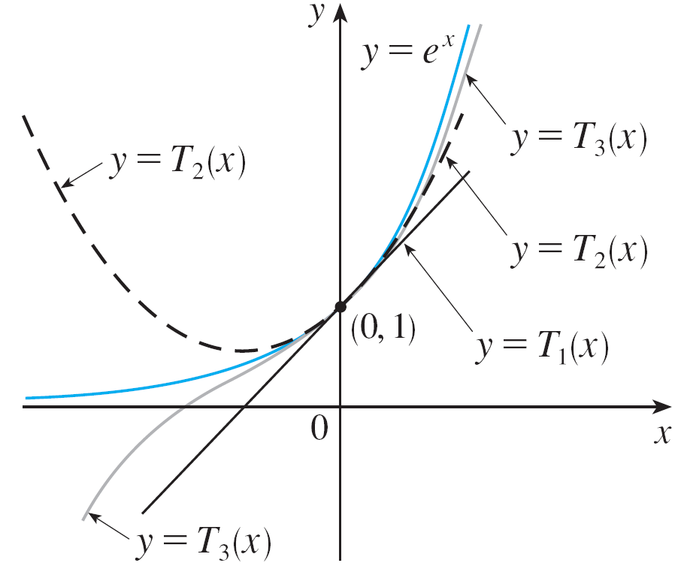
Taylor and Maclaurin Series
The graphs of the exponential function and these three Taylor polynomials are drawn in Figure 1.
As n increases, T_{n}(x) appears
to approach e^{x} in Figure 1.
This suggests that e^{x} is equal
to the sum of its Taylor series.
Figure 1

Slide 16




Taylor and Maclaurin Series
In general, f (x) is the sum of its Taylor series if
If we let
so that
then R_{n}(x) is called the remainder of the Taylor series.
If we can somehow show that then it follows that

Slide 17
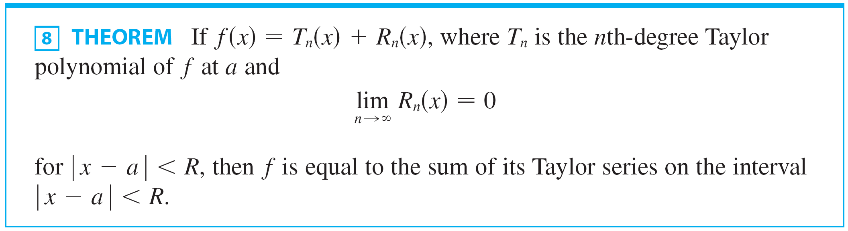
Taylor and Maclaurin Series
We have therefore proved the following.

Slide 18

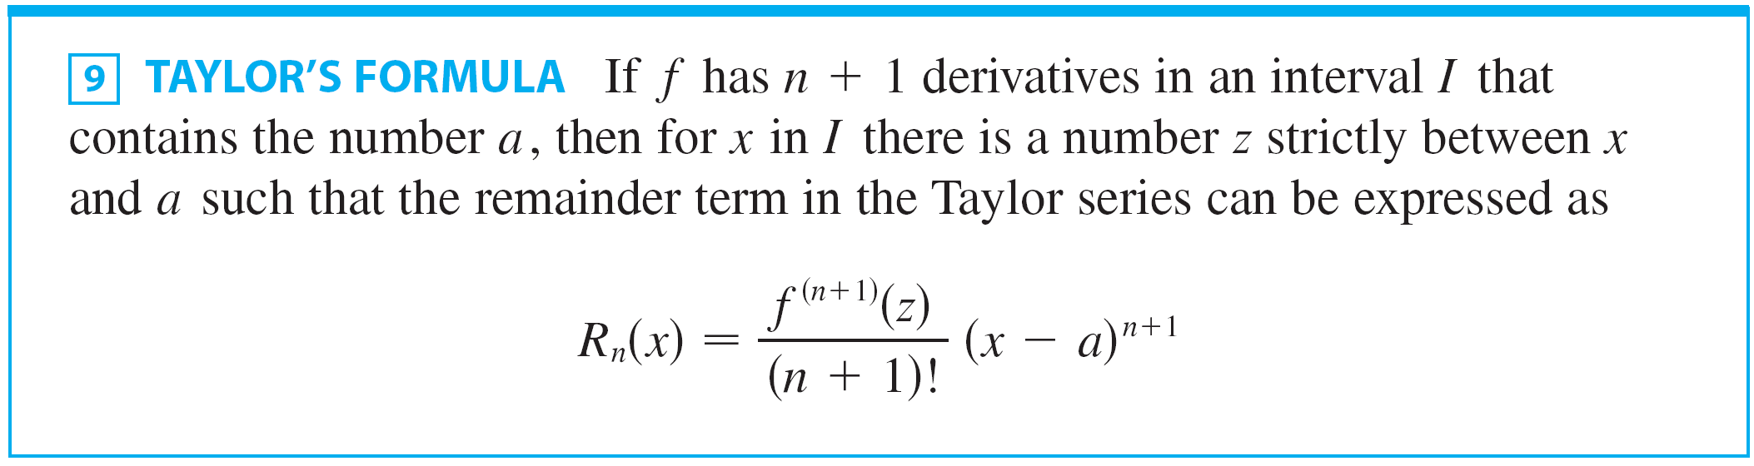
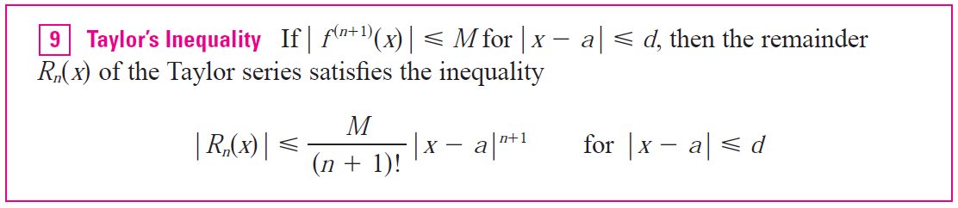
Taylor and Maclaurin Series
In trying to show that for a specific function f, we usually use the expression in the next theorem.

Slide 19
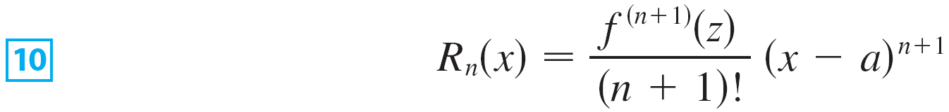

Taylor and Maclaurin Series
The remainder term is as follows:
The expression for R_{n}(x) in Equation 10 is known as Lagrange’s form of the remainder term.
In applying Theorems 8 and 9 it is often helpful to make use of the following fact.

Slide 20

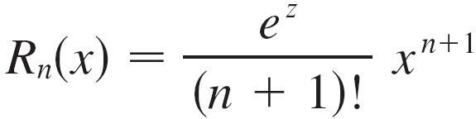
Example 2
Prove that e^{x} is equal to the sum of its Taylor series.
Solution:
If then so the remainder term in Taylor’s Formula is
where z lies between 0 and x. (Note, however, that z depends on n.)

Slide 21
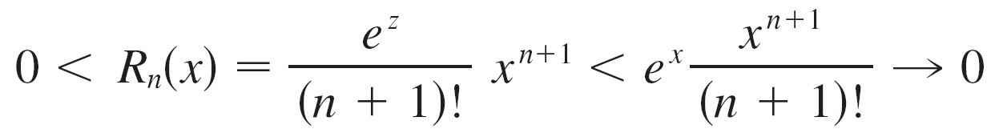


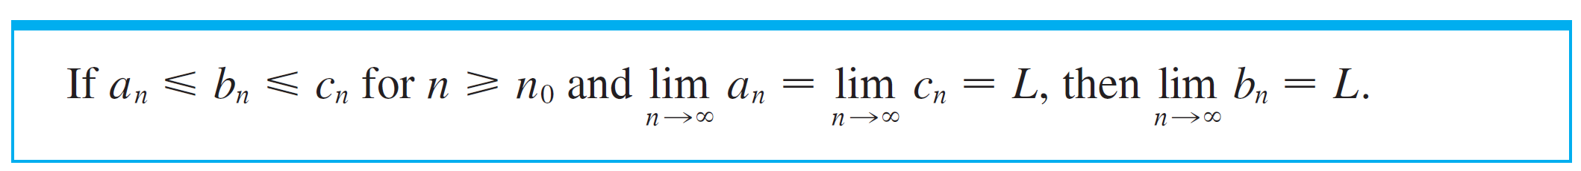
Example 2 – Solution
cont’d
If x > 0, then 0 < z < x, so e^{z} < e^{x}.
Therefore
by Equation 11, so as by the Squeeze Theorem.
The Squeeze Theorem is as follows:

Slide 22
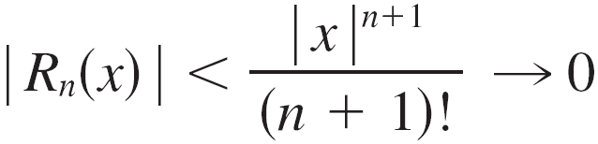
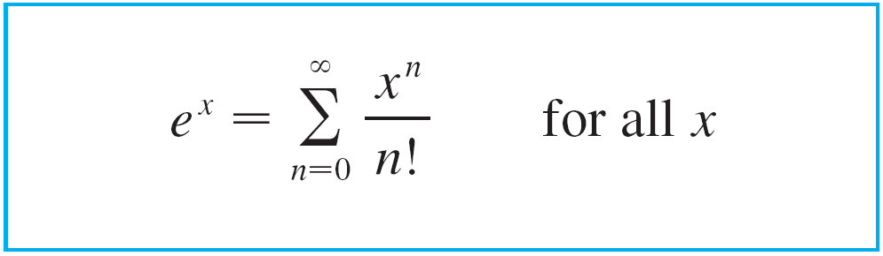

Example 2 – Solution
cont’d
If x < 0, then x < z < 0, so e^{z} < e⁰ = 1 and
Again . Thus, by Theorem 8, e^{x} is equal to the sum of its Taylor series, that is,

Slide 23
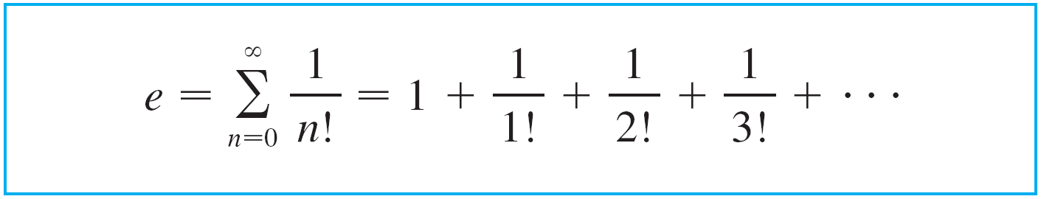

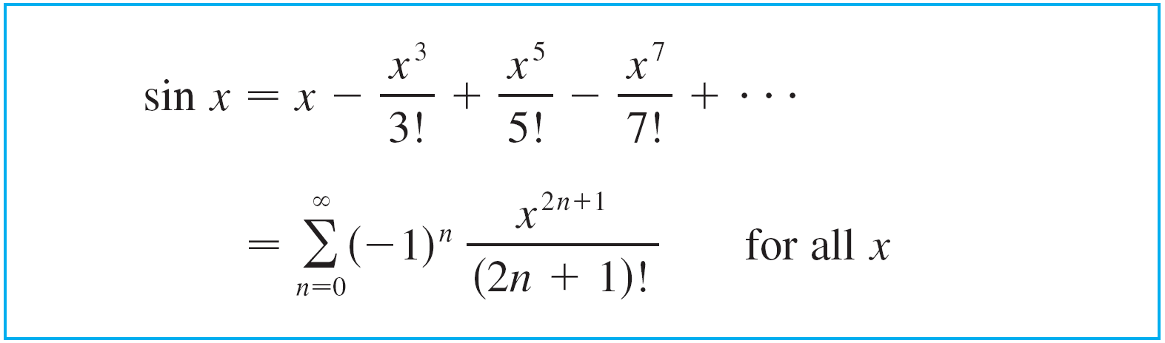

Taylor and Maclaurin Series
In particular, if we put x = 1 in Equation 12, we obtain the following expression for the number e as a sum of an infinite series:
The Maclaurin series for sin x is as follows:

Slide 24
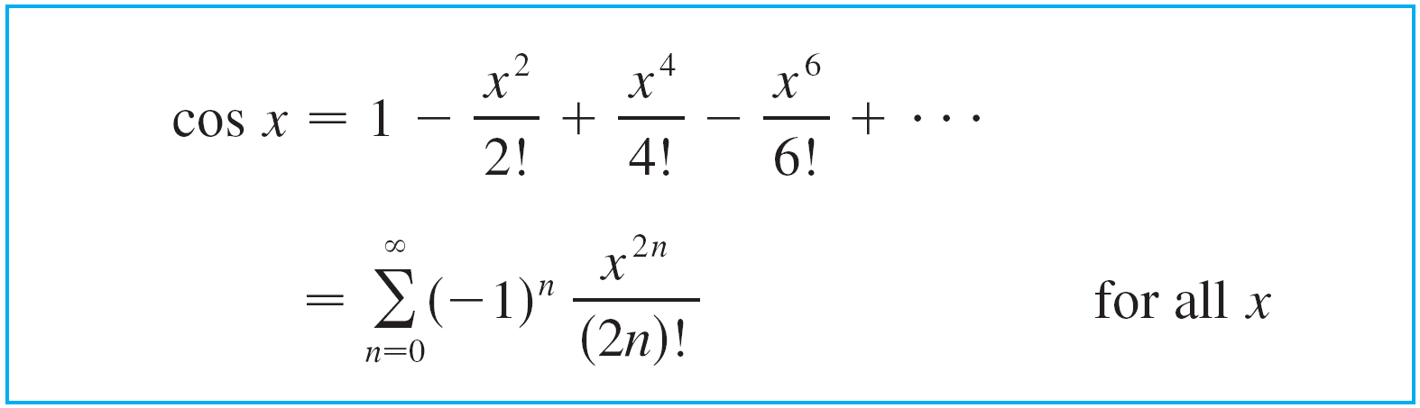


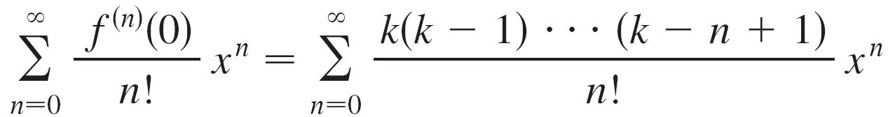
Taylor and Maclaurin Series
The Maclaurin series for cos x is as follows:
The Maclaurin series of is

Slide 25
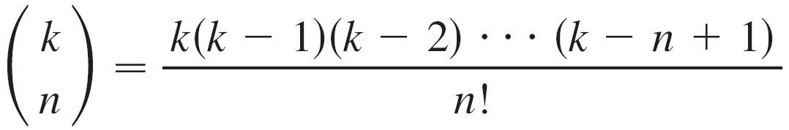
Taylor and Maclaurin Series
This series is called the binomial series. Notice that if k is a nonnegative integer, then the terms are eventually 0 and so the series is finite.
The traditional notation for the coefficients in the binomial series is
and these numbers are called the binomial coefficients.

Slide 26

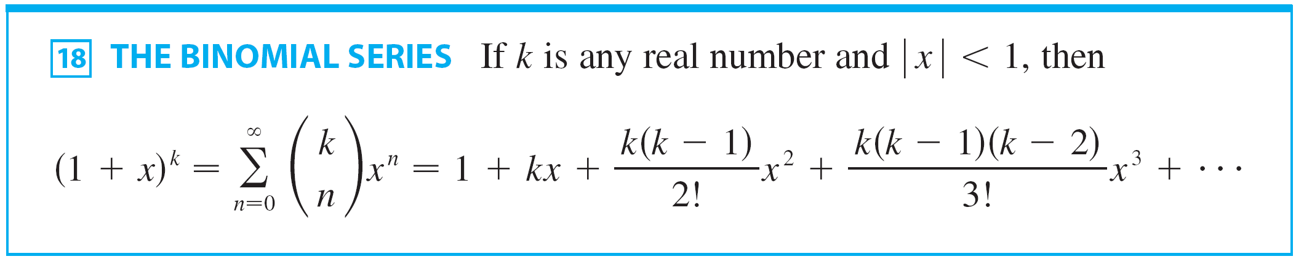
Taylor and Maclaurin Series
The following theorem states that is equal to the sum of its Maclaurin series.

Slide 27
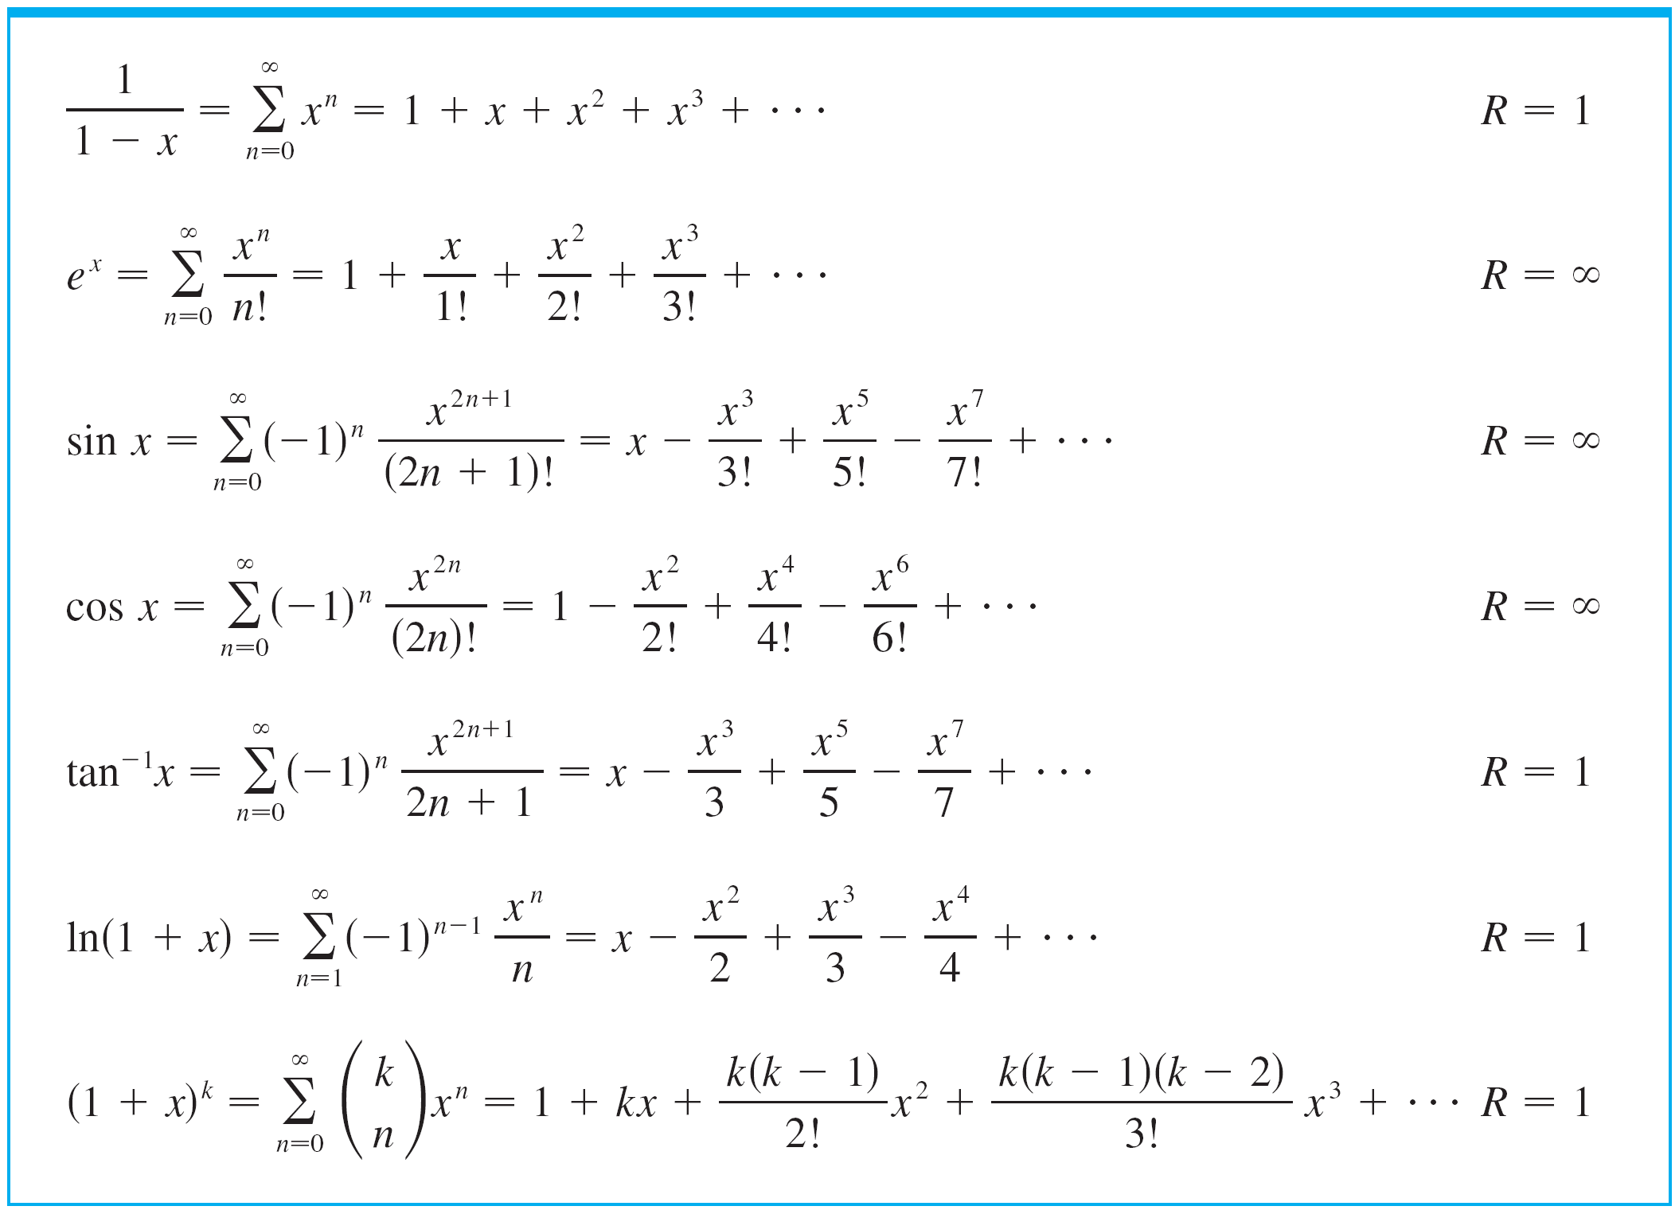
Taylor and Maclaurin Series
We collect in the following table, some important Maclaurin series that we have derived.
Important Maclaurin Series and Their Radii of Convergence
Table 1

Slide 28
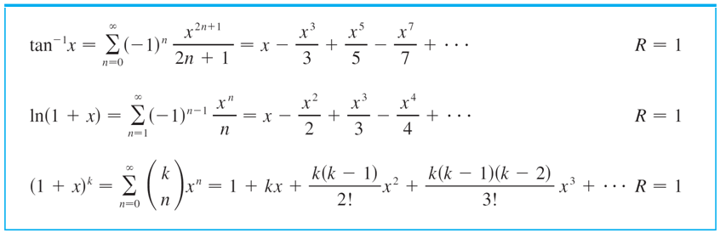
Taylor and Maclaurin Series
Important Maclaurin Series and Their Radii of Convergence
Table 1

Slide 29



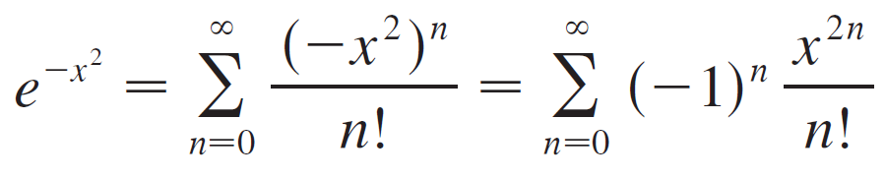
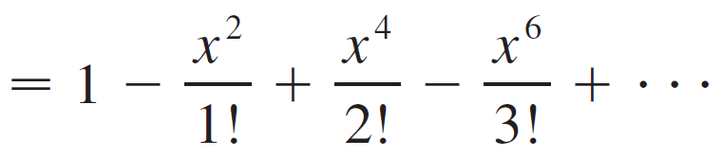
Example 9
(a) Evaluate as an infinite series.
(b) Evaluate correct to within an error of 0.001.
Solution:
(a) First we find the Maclaurin series for
Although it’s possible to use the direct method, let’s find
it simply by replacing x with –x² in the series for e^{x}
given in the table of Maclaurin series.
Thus, for all values of x,

Slide 30
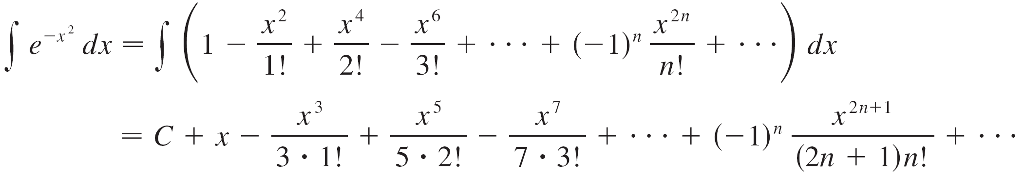

Example 9 – Solution
cont’d
Now we integrate term by term:
This series converges for all x because the original series for converges for all x.

Slide 31
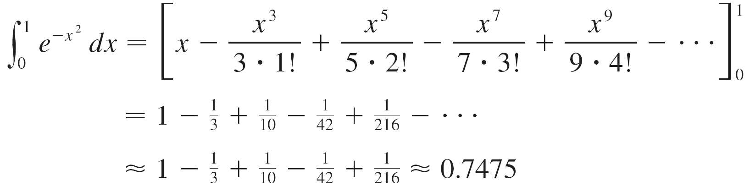
Example 9 – Solution
cont’d
(b) The Evaluation Theorem gives

Slide 32
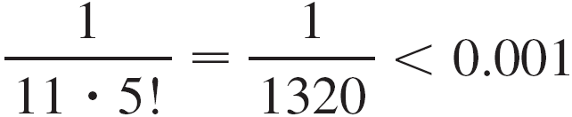
Example 9 – Solution
cont’d
The Alternating Series Estimation Theorem shows that the error involved in this approximation is less than

Slide 33
Multiplication and Division of Power Series

Slide 34
Multiplication and Division of Power Series
If power series are added or subtracted, they behave like polynomials.
In fact, as the next example illustrates, they can also be multiplied and divided like polynomials.

Slide 35
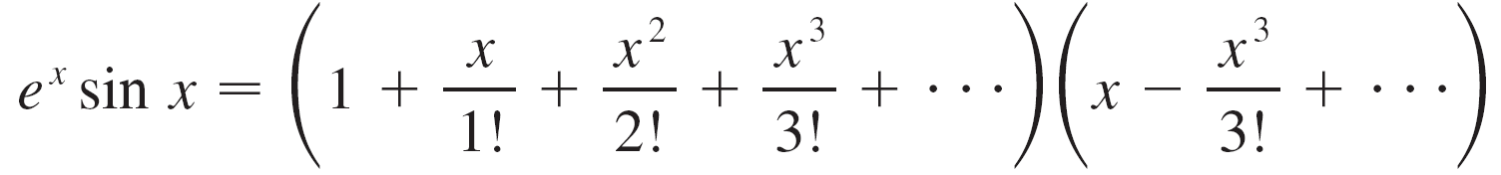
Example 11
Find the first three nonzero terms in the Maclaurin series for
(a) e^{x} sin x and
(b) tan x.
Solution:
(a) Using the Maclaurin series for e^{x} and sin x in Table 1,
we have

Slide 36
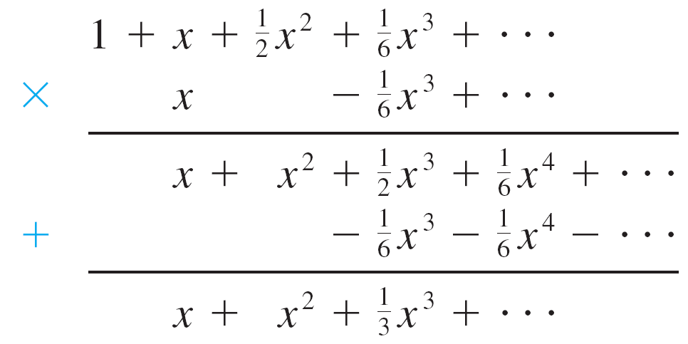

Example 11 – Solution
cont’d
We multiply these expressions, collecting like terms just as for polynomials:
Thus

Slide 37
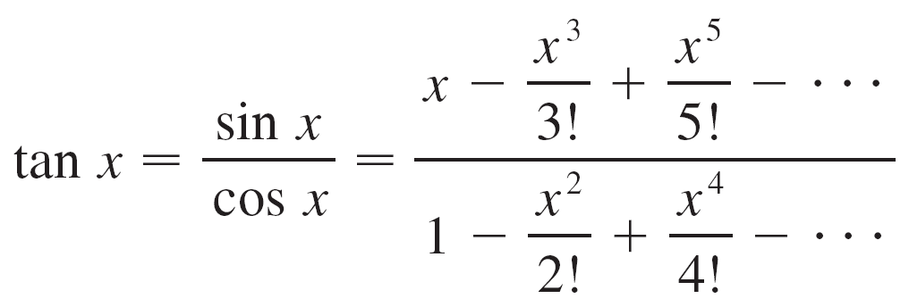
Example 11 – Solution
cont’d
(b) Using the Maclaurin series in the table, we have

Slide 38
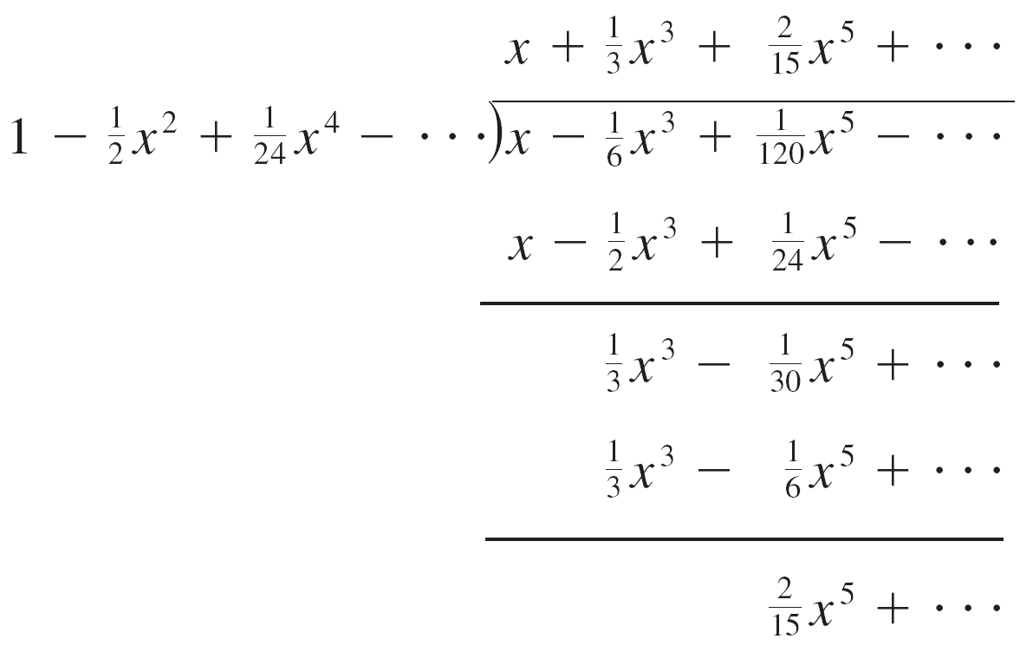

Example 11 – Solution
cont’d
We use a procedure like long division:
Thus

Slide 39
Proof of Taylor’s Formula

Slide 40

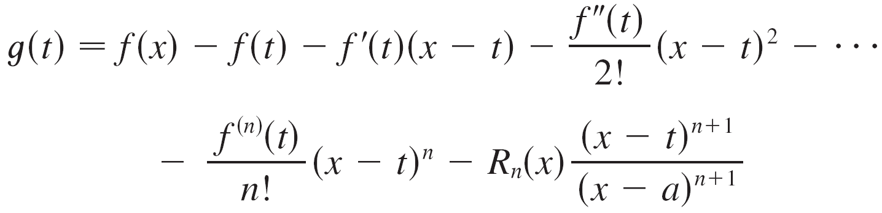
Proof of Taylor’s Formula
Let where T_{n} is the nth-degree Taylor polynomial of f at a.
We apply Rolle’s Theorem to a specially constructed function. We think x of as a constant, x ≠ a, and we define a function g on I by

Slide 41
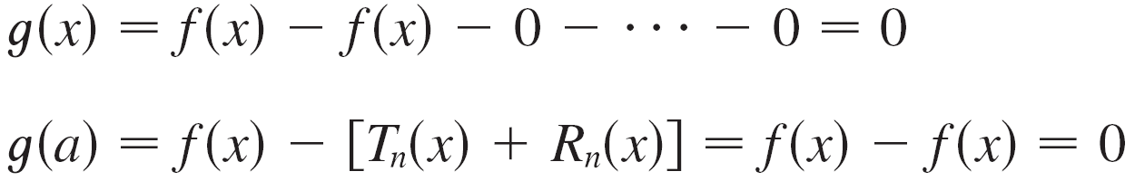
Proof of Taylor’s Formula
Then
Thus, by Rolle’s Theorem (applied to g on the interval from a to x), there is a number z between x and a such that
g ′(z) = 0.
If we differentiate the expression for g, then most terms cancel.

Slide 42
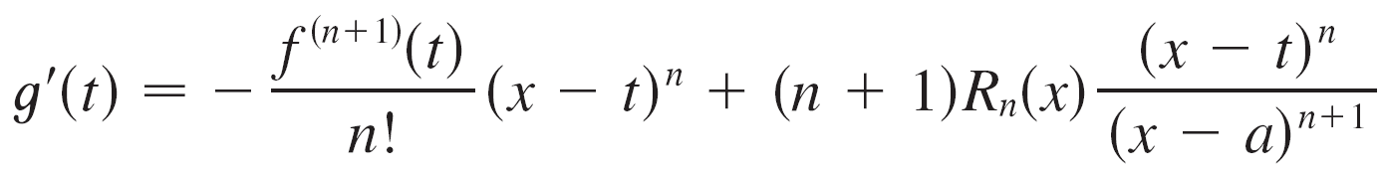
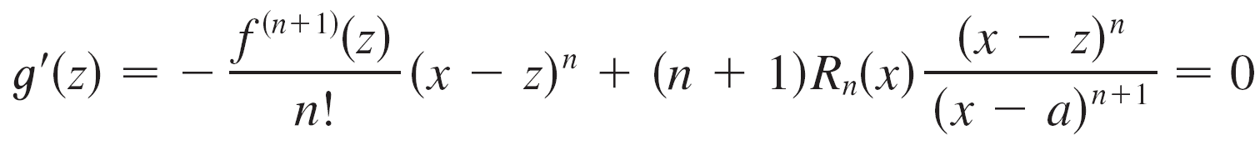
Proof of Taylor’s Formula
The expression for g ′(t) simplifies to
Thus we have

Slide 43
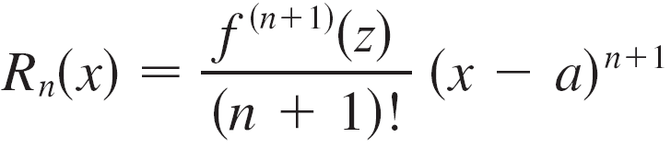
Proof of Taylor’s Formula
and so

